Slide 1
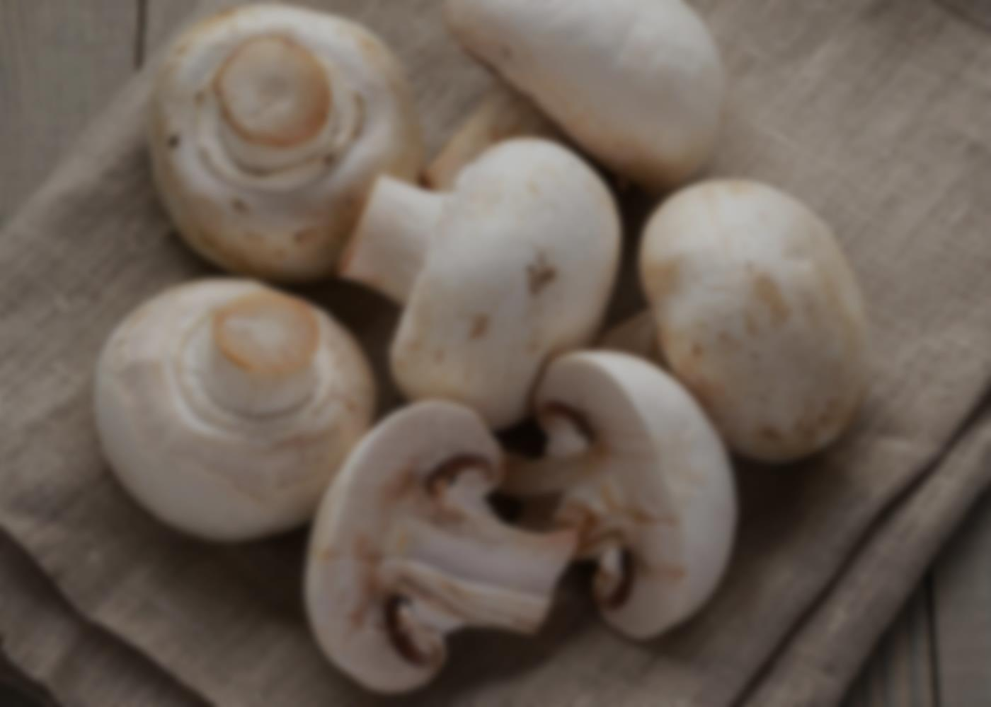
Identification of poisonous mushrooms based on their physical features- An ML based approach
Poojitha Bhat

Slide 2
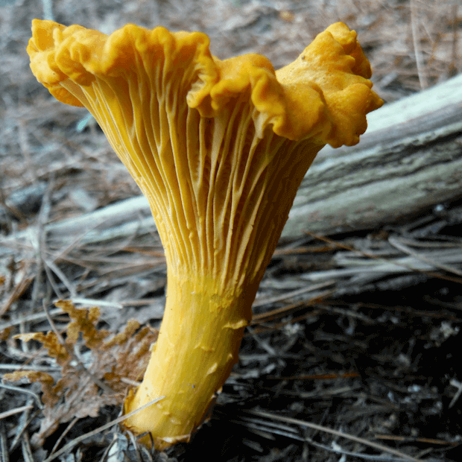
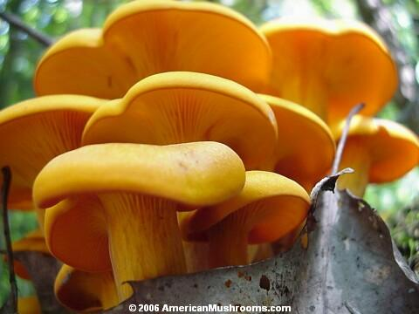
Mushrooms are deceptive
Chanterelle- The tasty edible variety
Jack-o-Lantern – The inedible variety

Slide 3
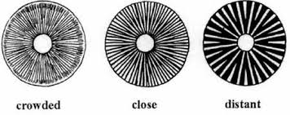
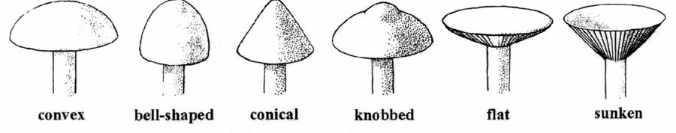
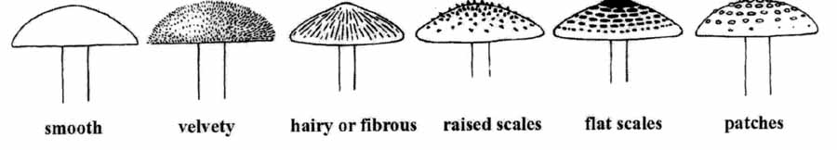
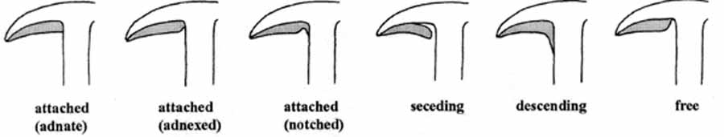
How Machine Learning can help?- Classification based on unique features
Gill types
Cap shapes
Cap Surface
Gill Attachment

Slide 4
Data Collection and Cleansing

Slide 5

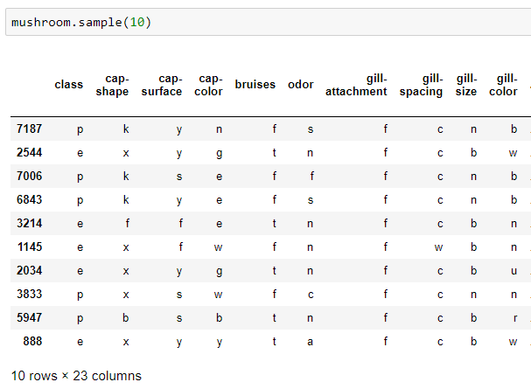
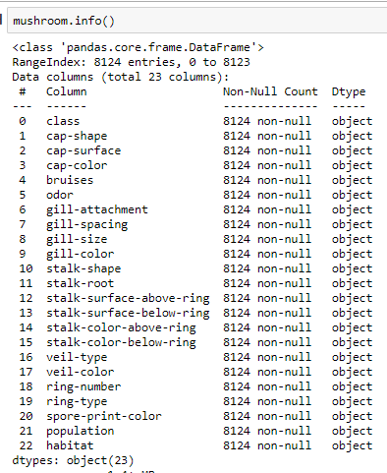
Mushroom Data obtained from UCI Machine Learning repository
Reading CSV file
Sampled Data
Overview of features

Slide 6
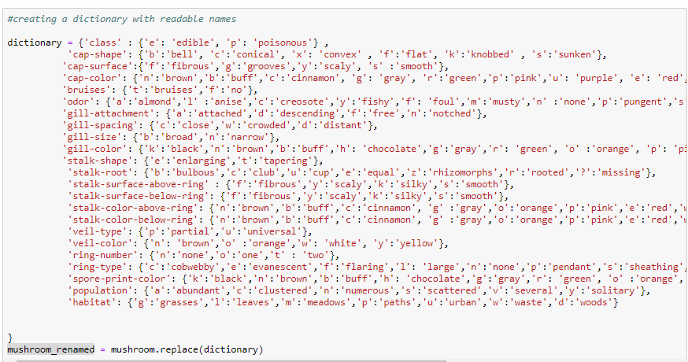
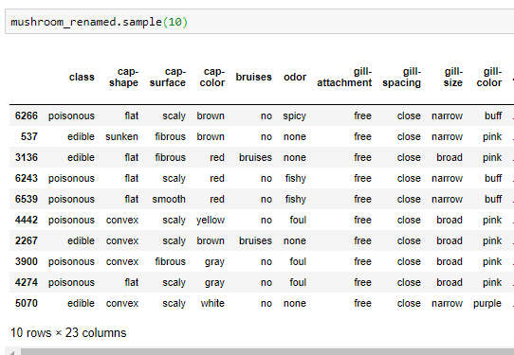
Conversion of Alphabet encoding to the actual classes
Creating dictionary of all the features
Final Dataset with all feature values replaced

Slide 7

Target Class
- No Missing values
- Only Edible and Poisonous mushrooms seen
- The target class seems to be balanced

Slide 8
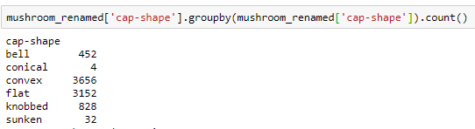

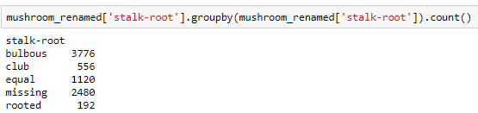

Independent Variables
Assumption made for missing stalk roots.

Slide 9

Exploratory Data Analysis

Slide 10
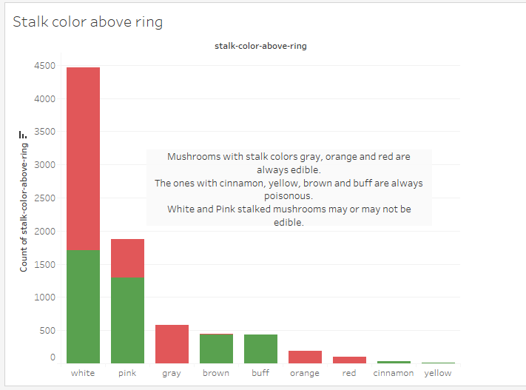

Slide 11
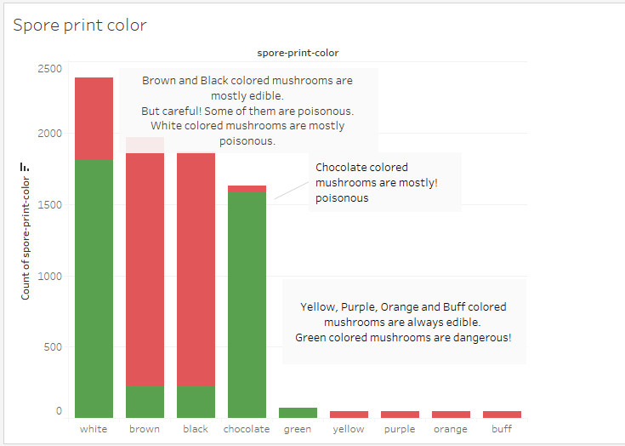

Slide 12
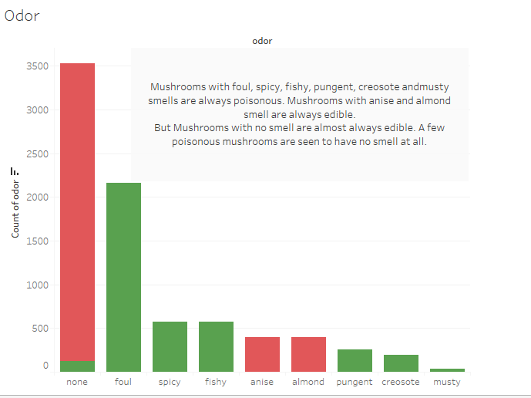

Slide 13
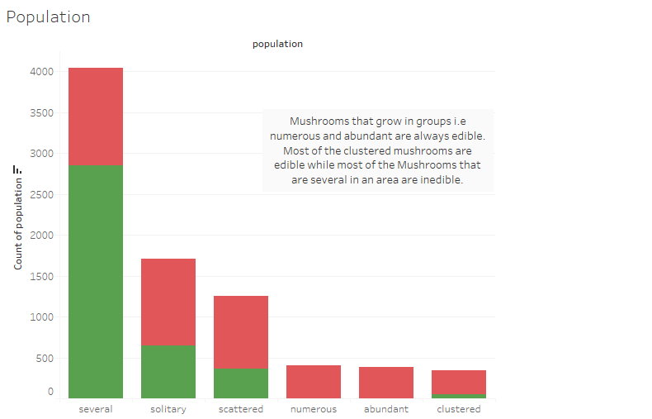

Slide 14
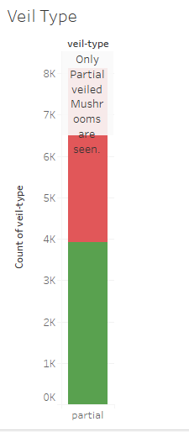

Slide 15
Findings from EDA
- Features like Stalk Color, Spore Print Color, Odor and Population Type may have a direct impact on the edibility of mushrooms.
- There is only one veil type seen and it needs to be eliminated.

Slide 16
Pre processing

Slide 17
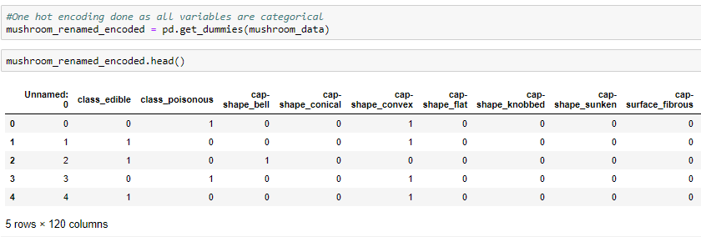
One Hot Encoding- As the categorical variables demand

Slide 18
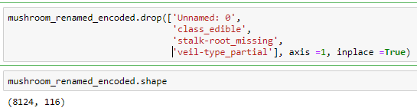
Dropping unnecessary/repetitive/invalid variables

Slide 19
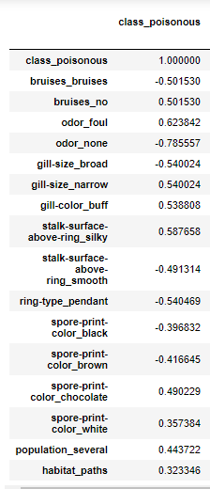
Correlation Analysis

Slide 20

Train/Test split

Slide 21
Model Development

Slide 22
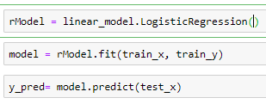
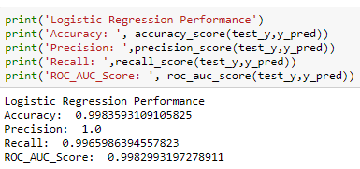
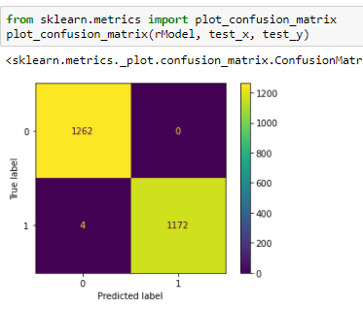
Logistic Regression- Simplest Classification Algorithm
Trained on default parameters
Close to 100% Accuracy/Recall seen.
4 mushrooms wrongly classified as edible.

Slide 23
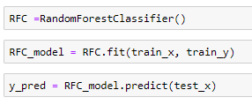
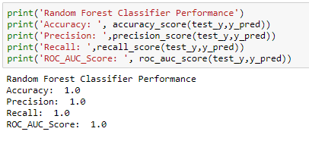
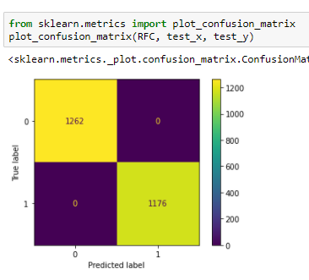
Random Forest Classifier- The Sharpshooter
Trained on default parameters
100% Accuracy, Precision and Recall seen
All Mushrooms perfectly classified!

Slide 24
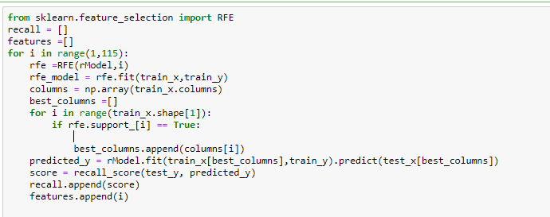
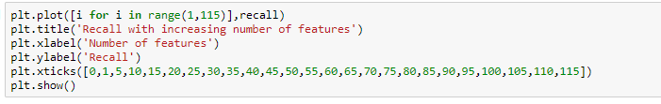
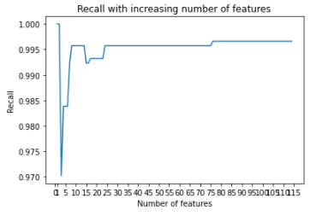
Data Leakage?
Strangely, Recall is 1 for 1 and 2 features and is seeing a fall after that.

Slide 25
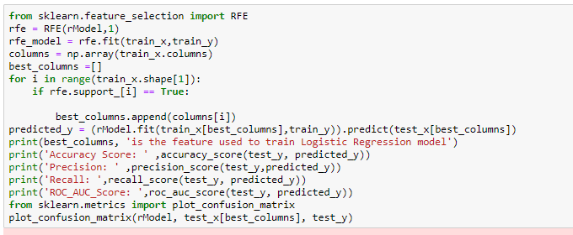
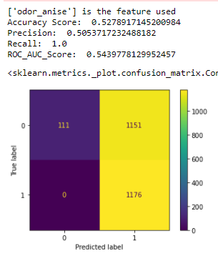
1 Feature to classify?

Slide 26
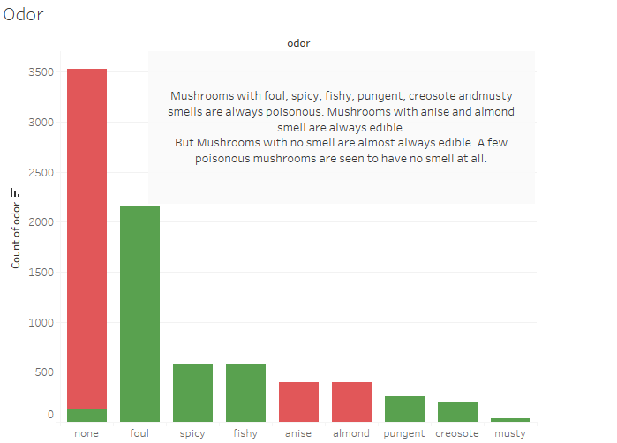

Slide 27
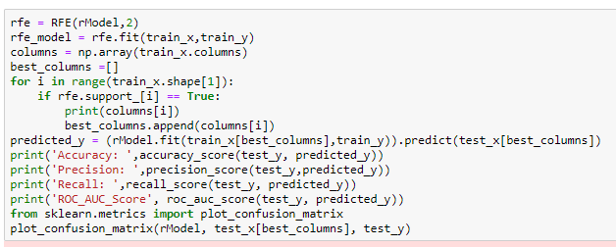
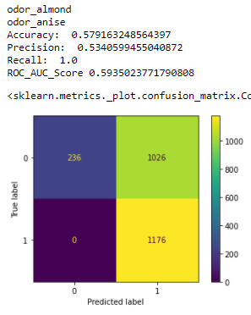
2 Features to classify?

Slide 28
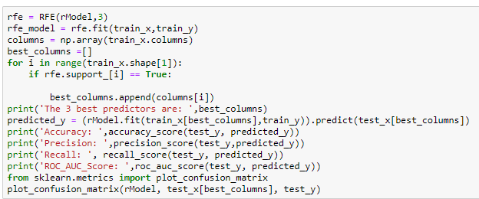
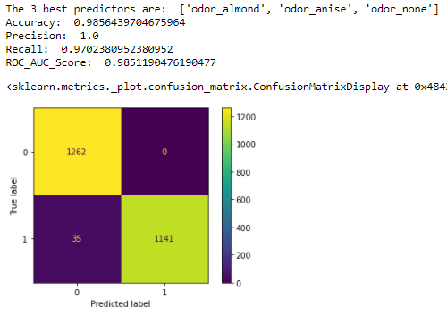
3 Features to classify?
Remarkable Recall/Accuracy/Precision with 3 features only.
But 35 poisonous mushrooms misclassified.

Slide 29
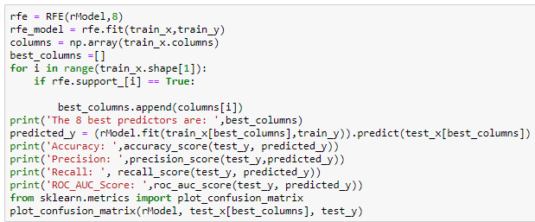
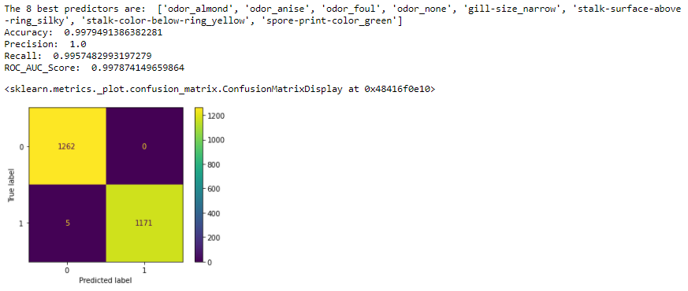
Eight best features
Performance similar to the default model

Slide 30
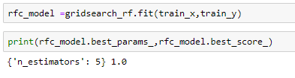
Tuning the Random Forest Classifier- n_estimators
Best Recall seen with only 5 estimators

Slide 31
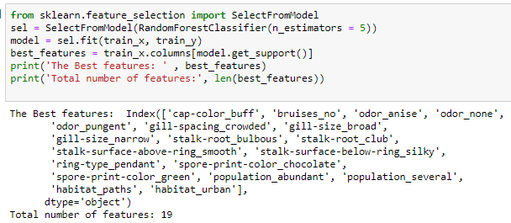
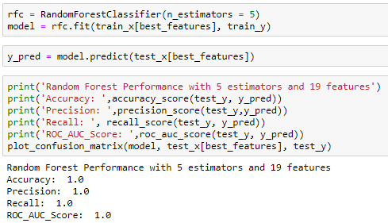
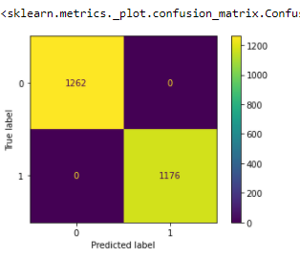
Tuning the Random Forest Classifier- best features
Accuracy/Precision/Recall of 100% with only 19 features.

Slide 32
THANK YOU!

